Slide 1
10- Python Implementations

Slide 2
Context
Python means 3
implementations of Python
CPython 4
Other implementations 6
Why do we have several implementations of Python? 8
there is one technical reason behind these implementations 9

Slide 3
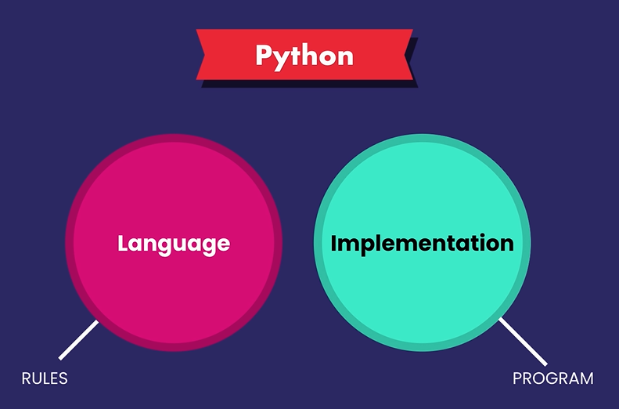
When we talk about python, we mean 2 separate things that are closely related:
Python language
Is just a specification that defines a set of rules and grammar for writing python code
particular implementation
Is a program that understands those rules and can execute python code.

Slide 4
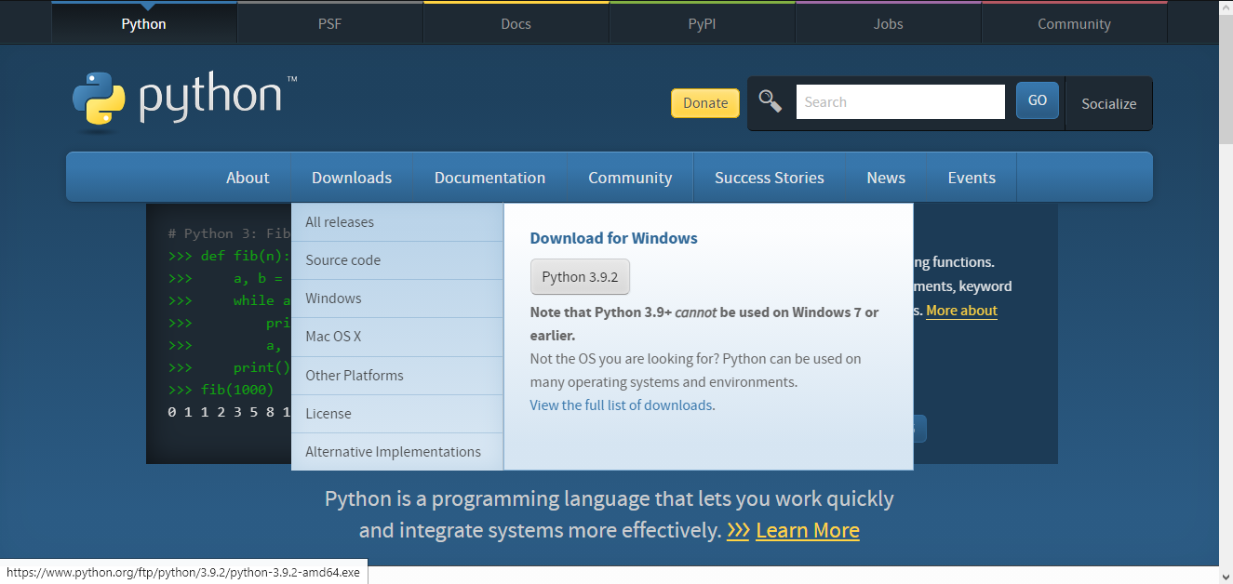
Earlier in the course we downloaded Python from Python.org
This is the default implementation of Python called Cpython
It's a program written in C, that's why it's called CPython

Slide 5
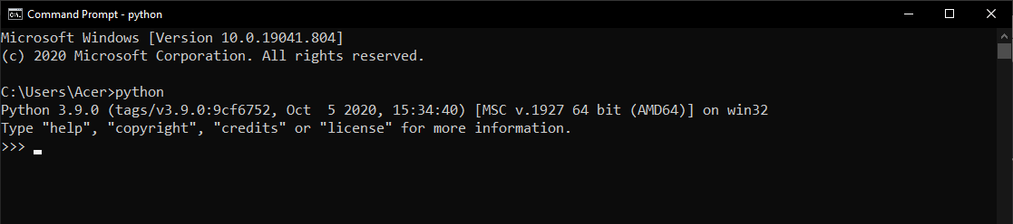
So here in terminal, when we run python we get this CPython

Slide 6
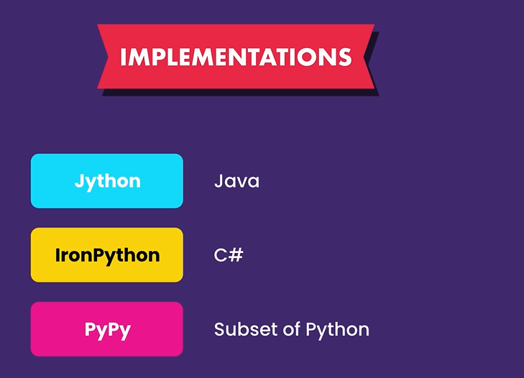
There are a few other implementations out there such as
Jython
written in Java,
IronPython
written in C#, and
PyPy
written in a subset of Python itself.

Slide 7
As new features are added to the Python language, they are first supported by CPython because that's the default implementation,
and then they will gradually come to the other implementations.
In theory if we give some python code to any of these implementations we should get the same result, but in practice that's not always the case. Certain features may be available in one implementation but not another, or they just behave a little bit differently in a particular implementation.
Now you might ask, what is the point of this?

Slide 8
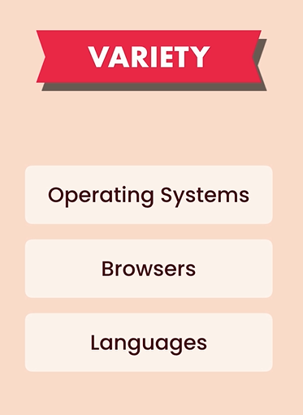
Why do we have several implementations of Python?
Wouldn't Cpythonn be enough?
Well, it's for the same reason we have multiple operating systems, Or multiple operating systems, or multiple browsers, or multiple programming languages.
After all these years, programmers haven't agreed on a single programming language, and that's the same story with Python implementation

Slide 9
There is one technical reason behind these implementations
However, there is one technical reason behind these implementations that you should be aware of.
Since Jython is implemented in Java, it allows you to reuse some existing Java code in a Python program. So if you're a Java developer and you want to import some Java code into a Python program, you should use Jython instead of Cpython.
Similarly IronPython is written in C#, so if you're a C# developer, and want to bring some C# code into a Python program, you will have to use IronPython.

